Slide 1

DISCRETE STRUCTURES
COURSE CODE:
MATH 103 / 121
LECTURE SLIDES ON SET THEORY
BY
MR. ANTHONY KWARTENG

Slide 2
SET THEORY
Definition of a Set
A set is collection of well defined objects.
It can also be referred to a group of items with common properties or purpose.
E.g. i. A set of cutlery: here all the elements of the set are used for a
common purpose, (i.e. for dinner).
ii. A mathematical set: the elements are for construction purpose.
You can give some examples of set and explain why they are sets.
Notations of Sets
The elements of a set are usually denoted by lower-case letters. While sets are
denoted by capital letters.
The symbol ∈ indicates the membership in a set.
For instance, if “a is an element of the set A”, then we write a ∈ A.
The symbol ∉ denotes “is not a member of ” or “does not belong to”.

Slide 3
∪ - union; A ∪ B combines all the elements in both A and B without repetitions
∩ - intersection: it groups the all the elements that belong to or find in all the sets involved
A∩B selects all the elements in both A and B
⊂ - Subset; A ⊂ B means all the elements in A are found in B
⊃ - Super set: B ⊃ A reads B contains A; A contain in B or B is the super set of A
B ⊃ A ≡ A ⊂ B:
⊆ - Subset or equal sets
⊇ - Super set or equal sets
∅ or {} - Empty or null set: it’s a set without an element
Etc.

Slide 4
It is convenient to name certain standard sets so that we can refer to them easily. ℕ = set of all nonnegative integers including 0(i.e. set of positive whole numbers) ℤ = set of all integers ℚ = set of all rational numbers ℝ = set of all real numbers ℂ = set of all complex numbers

Slide 5
Sets Representations
The sets can be represented in five ways:
The Roster Method:
In the roster method, all the members of the set are listed in
between a pair of braces.
E.g. {1, 2, 3}, {3, 6, 9, 12, 15}, {a, b, c, d} represent sets.
This method is also called “The listing method” or Tabulation.
Using a Set Builder Notation:
By a description of some attributes or characteristics of the
elements of the set.
This method is more general and involves a description of the
set property.

Slide 6
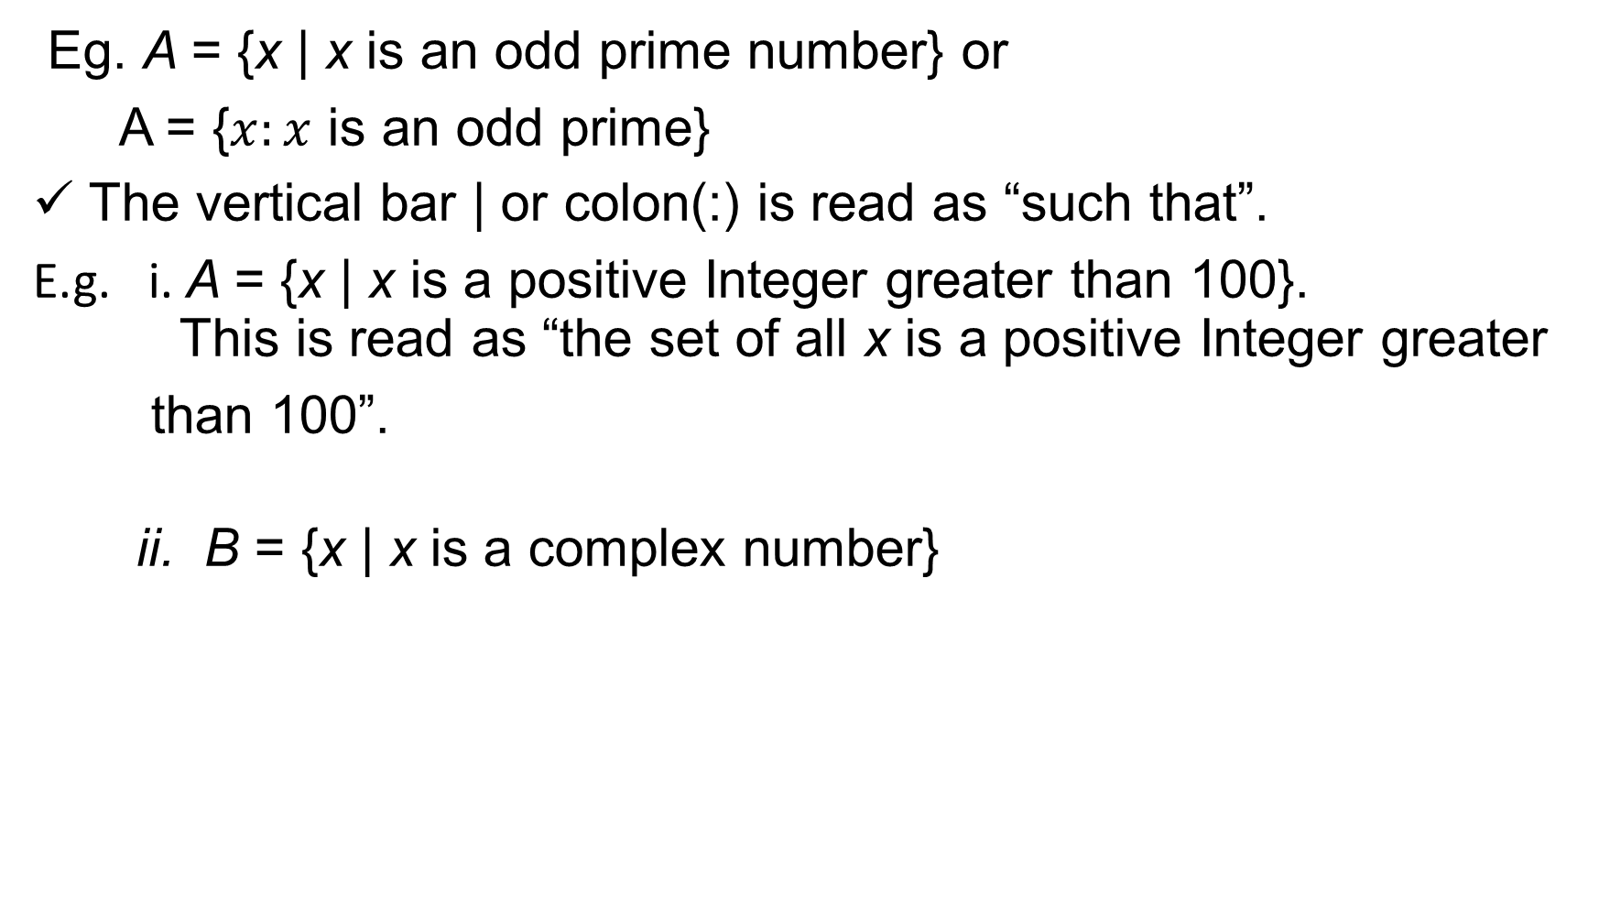
Eg. A = {x | x is an odd prime number} or
A = {$x:x$ is an odd prime}
The vertical bar | or colon(:) is read as “such that”.
E.g. i. A = {x | x is a positive Integer greater than 100}. This is read as “the set of all x is a positive Integer greater
than 100”.
ii. B = {x | x is a complex number}

Slide 7
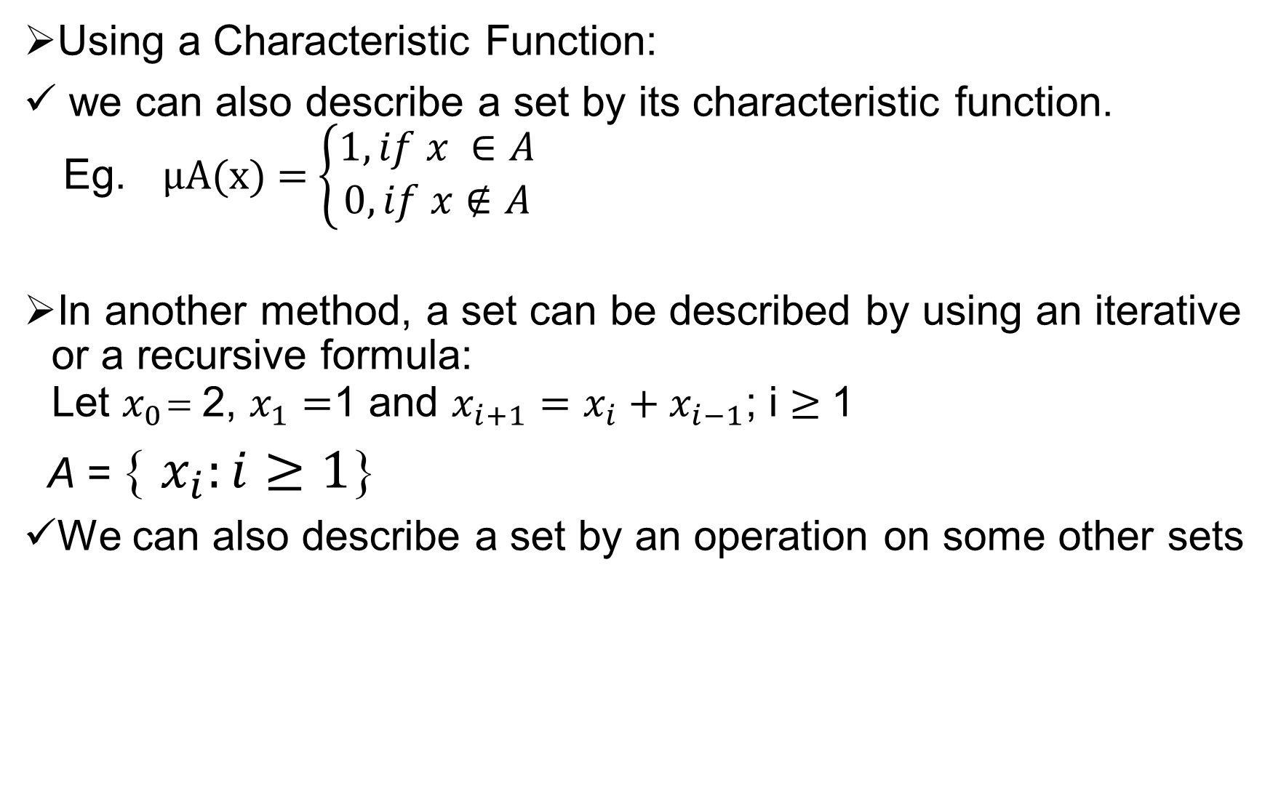
Using a Characteristic Function:
we can also describe a set by its characteristic function. Eg. μA(x) = $\left\{\begin{matrix}1, if x ∈A \\ 0, if x∉A\end{matrix}\right.$
In another method, a set can be described by using an iterative or a recursive formula: Let $x_{0}$ = 2, $x_{1}=$1 and $x_{i+1}=x_{i}+x_{i−1}$; i ≥ 1
A = { $x_{i}:i≥1$}
We can also describe a set by an operation on some other sets

Slide 8
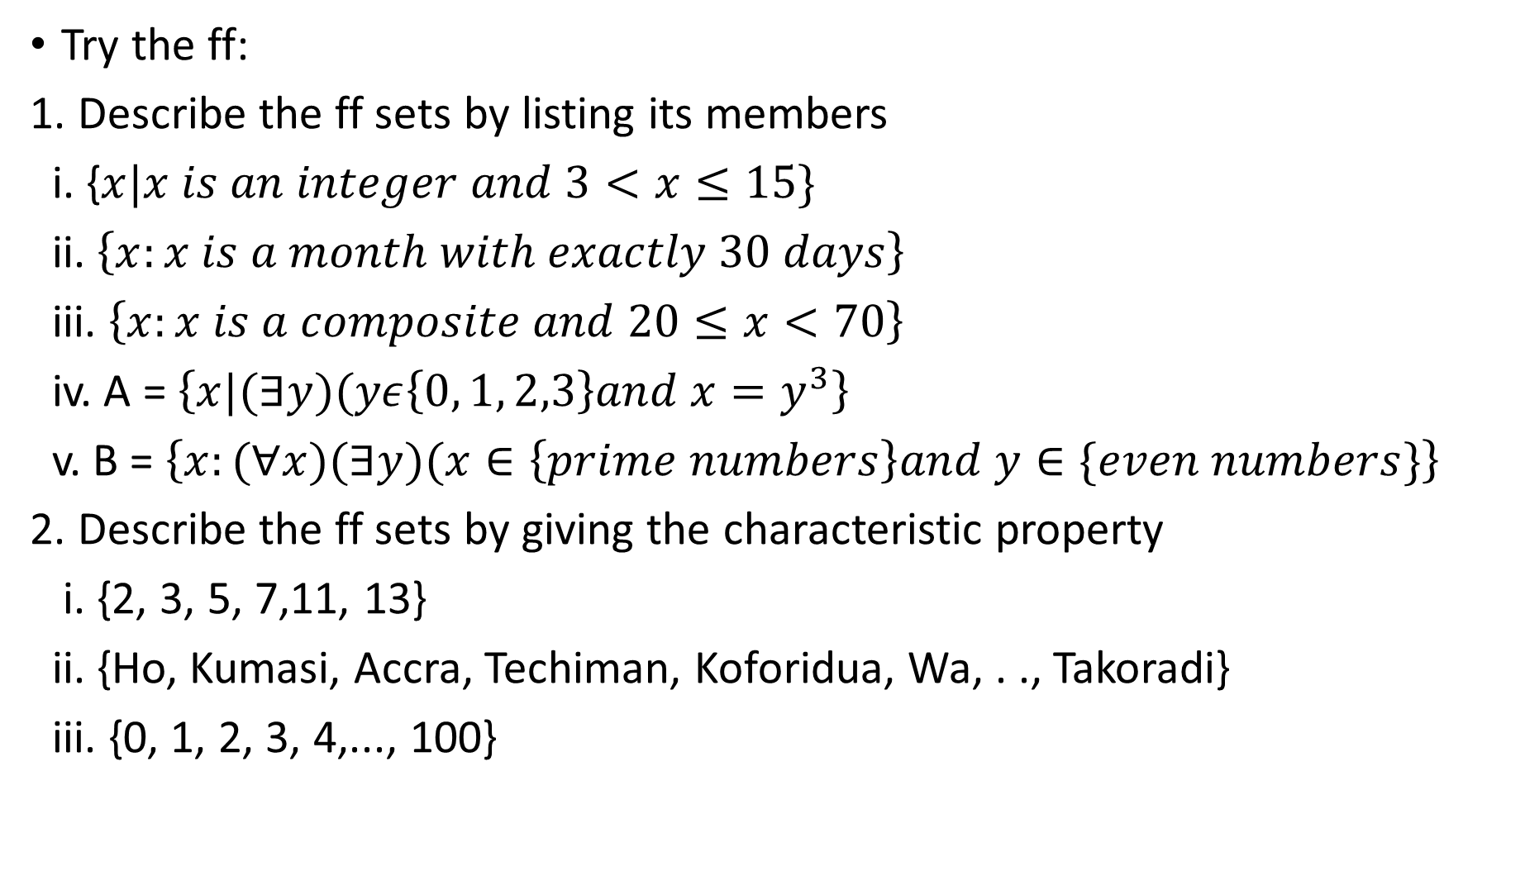
Try the ff:
1. Describe the ff sets by listing its members
i. {$x|x is an integer and 3<x≤15\}$
ii. $\left\{x:x is a month with exactly 30 days\right\}$
iii. $\left\{x:x is a composite and 20≤x<70\right\}$
iv. A = $\left\{x|(∃y)(yε\left\{0, 1, 2,3\right\}and x=y^{3}\right\}$
v. B = $\left\{x:(∀x)(∃y)(x∈\left\{prime numbers\right\}and y∈\{even numbers\}\right\}$
2. Describe the ff sets by giving the characteristic property
i. {2, 3, 5, 7,11, 13}
ii. {Ho, Kumasi, Accra, Techiman, Koforidua, Wa, . ., Takoradi}
iii. {0, 1, 2, 3, 4,..., 100}

Slide 9
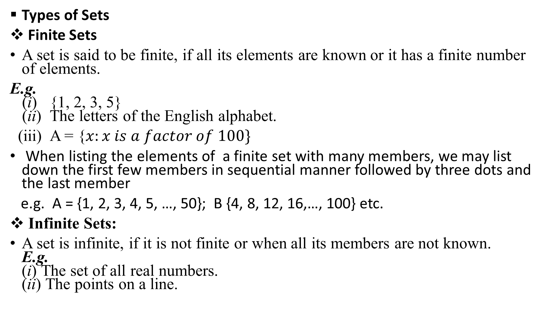
Types of Sets
Finite Sets
A set is said to be finite, if all its elements are known or it has a finite number of elements.
E.g. (i) {1, 2, 3, 5} (ii) The letters of the English alphabet.
(iii) A = {$x:x is a factor of 100\}$
When listing the elements of a finite set with many members, we may list down the first few members in sequential manner followed by three dots and the last member
e.g. A = {1, 2, 3, 4, 5, …, 50}; B {4, 8, 12, 16,…, 100} etc.
Infinite Sets:
A set is infinite, if it is not finite or when all its members are not known. E.g. (i) The set of all real numbers. (ii) The points on a line.

Slide 10
Members of infinite sets can be listed by listing down first few members followed by three dots or infinity (∞).
E.g.
A = { 2, 4, 6, 8, …,}; B = {1, 3, 5, 7, …, ∞}
Universal Set:
In many discussions on certain sets, all the concerned sets are considered to be subsets of one particular set or bigger set. This set is called the universal set.
The Universal set is often designated by the script letter U (or by X). Universal set in not unique, and it may change from one discussion to another. Example: If A = {0, 2, 7}, B = {3, 5, 6}, C = {1, 8, 9, 10} then the universal set can be taken as the set. U = {0, 1, 2, 3, 4, 5, 6, 7, 8, 9, 10, 11, 12}.

Slide 11
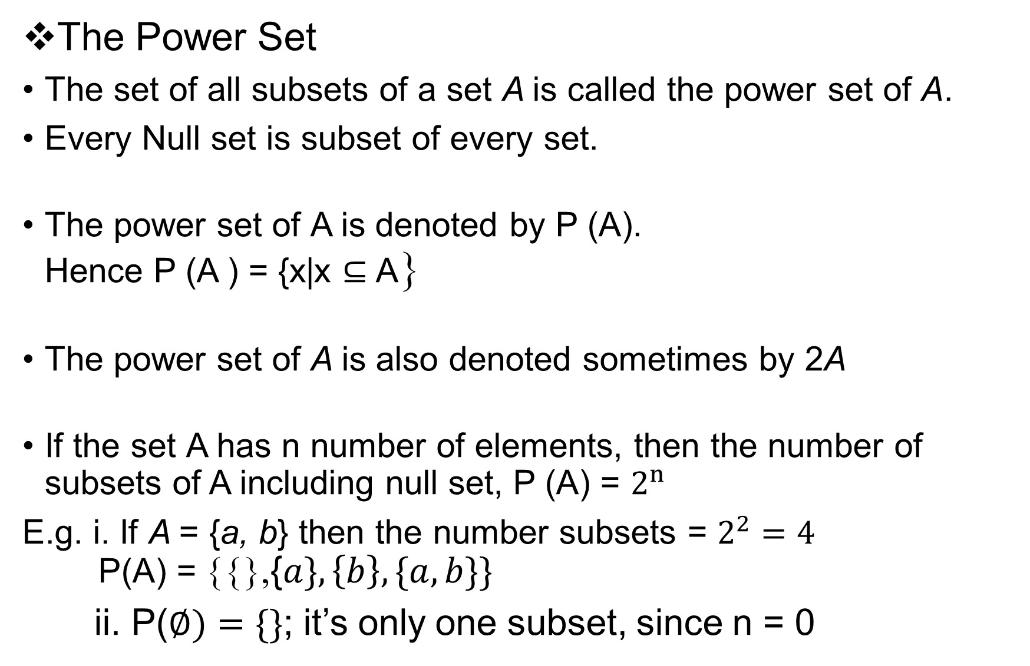
The Power Set
The set of all subsets of a set A is called the power set of A.
Every Null set is subset of every set.
The power set of A is denoted by P (A). Hence P (A ) = {x|x ⊆ A}
The power set of A is also denoted sometimes by 2A
If the set A has n number of elements, then the number of subsets of A including null set, P (A) = $2^{n}$
E.g. i. If A = {a, b} then the number subsets = $2^{2}=4$ P(A) = {{},{$a\},\left\{b\right\},\{a, b\}\}$
ii. P($∅)=\{\}$; it’s only one subset, since n = 0

Slide 12
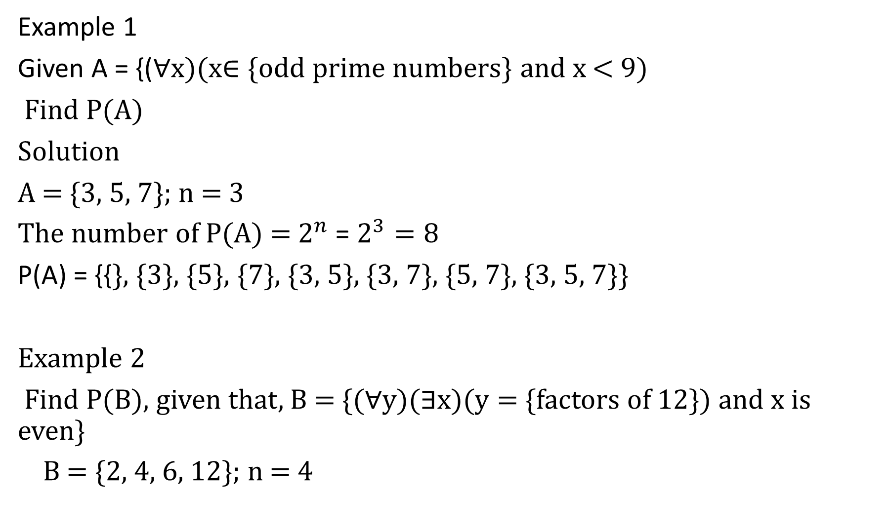
Example 1
Given A = {(∀x)(x∈ {odd prime numbers} and x < 9)
Find P(A)
Solution
A = {3, 5, 7}; n = 3
The number of P(A) = $2^{n}$ = $2^{3}=8$
P(A) = {{}, {3}, {5}, {7}, {3, 5}, {3, 7}, {5, 7}, {3, 5, 7}}
Example 2
Find P(B), given that, B = {(∀y)(∃x)(y = {factors of 12}) and x is even}
B = {2, 4, 6, 12}; n = 4

Slide 13
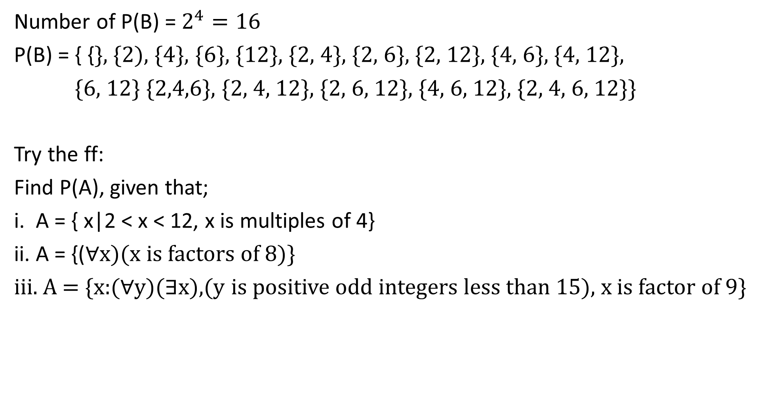
Number of P(B) = $2^{4}=16$
P(B) = { {}, {2), {4}, {6}, {12}, {2, 4}, {2, 6}, {2, 12}, {4, 6}, {4, 12},
{6, 12} {2,4,6}, {2, 4, 12}, {2, 6, 12}, {4, 6, 12}, {2, 4, 6, 12}}
Try the ff:
Find P(A), given that;
i. A = { x|2 < x < 12, x is multiples of 4}
ii. A = {(∀x)(x is factors of 8)}
iii. A = {x:(∀y)(∃x),(y is positive odd integers less than 15), x is factor of 9}

Slide 14
Cardinality of a Set
The cardinality of a set is the number of elements in the set.
It defines the size of the set
The cardinality of a set A is denoted by |A| or n(A).
e.g. the cardinality of A = {a, b, c, d} is given by
|A| = 4
Examples:
Find the cardinality of the ff:
i. A = {x|3 ≤ x < 20, x ∈ ℤ}
ii. B = {x : x is multiples of 5 less than 50}
iii. C = {(∀x)(x ∈{integers less than 30}, x is even}

Slide 15
Solution:
i. A = {x|3 ≤ x < 20, x ∈ ℤ}
A = {3, 4, 5, 6, 7, 8, 9, 10, 11, 12, 13, 14, 15, 16, 17, 18, 19}
|A| = 17
ii. B = {x : x is multiples of 5 less than 50}
B = {5, 10, 15, 20, 25, 30, 35, 40, 45}
|B| = 9
iii. C = {(∀x)(x ∈{positive integers less than 30}, x is even}
C = {2, 4, 6, 8, 10, 12, 14, 16, 18, 20, 22, 24, 26, 28}
|C| = 14

Slide 16
Cardinality of union
If A and B are any two finite sets then, the numbers of elements in A ∪B is denoted by | A ∪ B| or n(A∪B).
|A ∪B | = |A| + |B | - |A∩B| or n(A ∪ B) = n(A) + n(B) – n(A ∩ B)
Similarly |A ∪ B ∪ C| = |A|+|B|+|C|- |A∩B|-|A∩C|-|B ∩ C| +|A∩B∩C| e.g. 1
Given, A = {1, 2, 3, 4, 5}, B = {2, 3, 4, 6} and C = {3, 4, 6, 8}
Find i. n(A ∪ B), ii. |A ∪ B ∪ C| = {1, 2, 3, 4, 5, 6, 8}
solution
A ∪ B = {1, 2, 3, 4, 5, 6} : n(A ∪ B) = 6
A ∪ B ∪ C = {1, 2, 3, 4, 5, 6, 8}: n(A ∪ B ∪ C) = 7
Alt:
|A| = 5, |B| = 4, |C| = 4
A∩B = {2, 3, 4}; |A ∩ B| = 3

Slide 17
A ∩ C = {3, 4} ; |A ∩ C| = 2
B ∩ C = {3, 4, 6}; |B ∩ C| = 3
A ∩ B ∩ C = {3, 4}; |A∩ B ∩ C| = 2
i. |A ∪ B| = |A| + |B| - |A ∩ B|
= 5 + 4 – 3 = 6
|A ∪ B ∪ C| = |A|+|B|+|C|- |A ∩ B|-|A ∩ C|-|B ∩ C| +|A ∩ B ∩ C|
= 5 + 4 + 4 – 3 – 2 – 3 + 2 = 7

Slide 18
Example 2
At the end of GCTU courses registration, it revealed that 50 students of BIT level 100 students at Ho campus were able to register. Out of 50, 30 registered for Communication Skills (C), 25 registered for French (F) and 15 registered for Discrete Structures (D)
If 8 registered for both Communication Skills and French, 10 registered for Communication Skills and Discrete Structures and 5 registered for French and Discrete Structures. If all the students registered at least one of the courses, find the number of students who registered for all the three courses

Slide 19
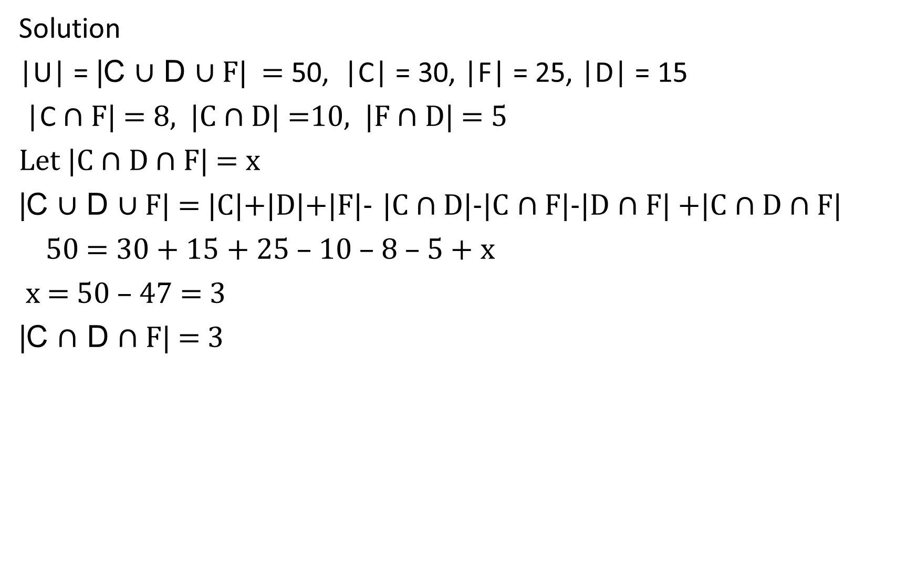
Solution
|U| = |C ∪ D ∪ F| = 50, |C| = 30, |F| = 25, |D| = 15
|C ∩ F| = 8, |C ∩ D| =10, |F ∩ D| = 5
Let |C ∩ D ∩ F| = x
|C ∪ D ∪ F| = |C|+|D|+|F|- |C ∩ D|-|C ∩ F|-|D ∩ F| +|C ∩ D ∩ F|
50 = 30 + 15 + 25 – 10 – 8 – 5 + x
x = 50 – 47 = 3
|C $∩$ D $∩$ F| = 3

Slide 20
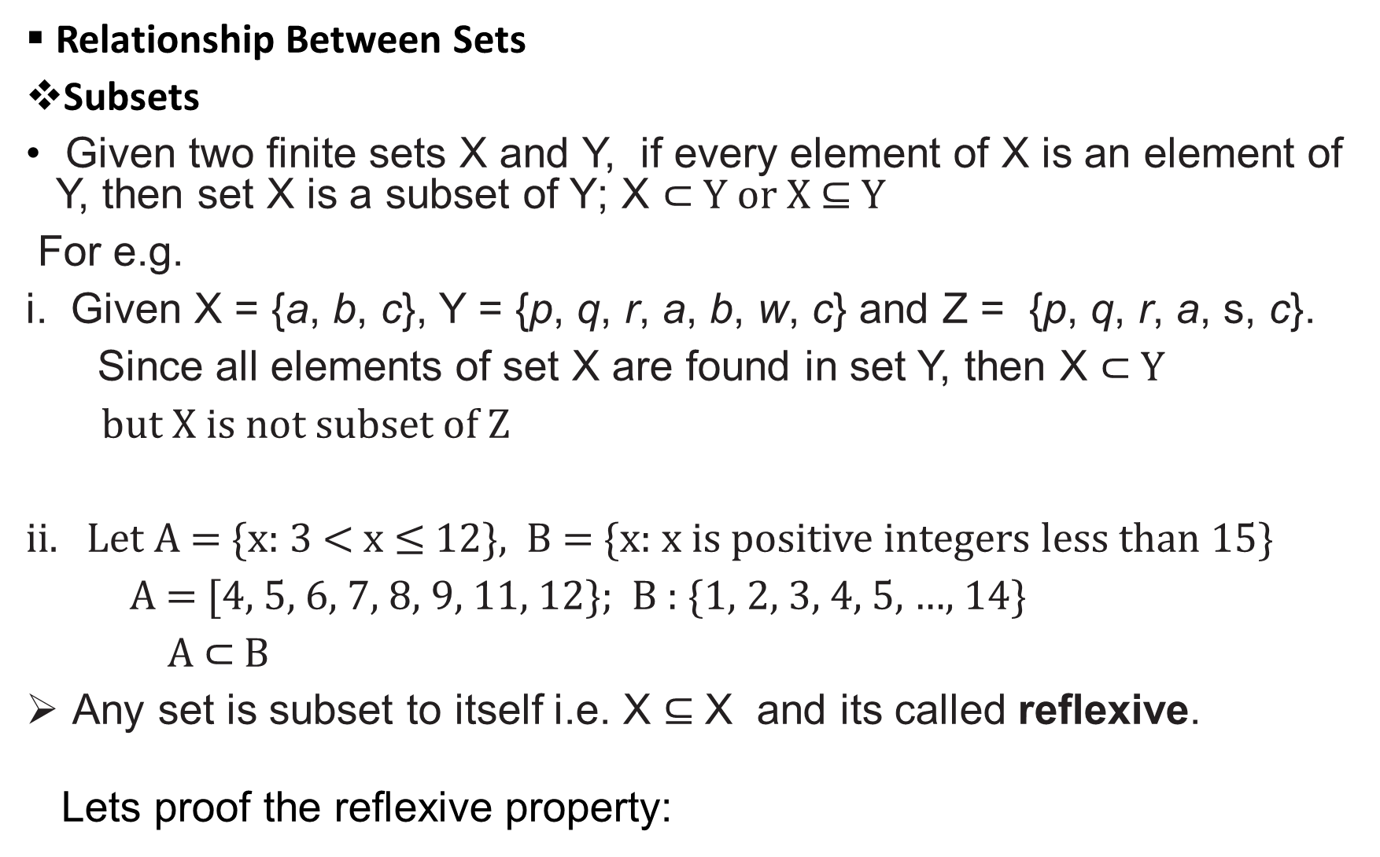
Relationship Between Sets
Subsets
Given two finite sets X and Y, if every element of X is an element of Y, then set X is a subset of Y; X ⊂ Y or X ⊆ Y
For e.g.
i. Given X = {a, b, c}, Y = {p, q, r, a, b, w, c} and Z = {p, q, r, a, s, c}.
Since all elements of set X are found in set Y, then X ⊂ Y
but X is not subset of Z
ii. Let A = {x: 3 < x ≤ 12}, B = {x: x is positive integers less than 15}
A = [4, 5, 6, 7, 8, 9, 11, 12}; B : {1, 2, 3, 4, 5, …, 14}
A $⊂$ B
Any set is subset to itself i.e. X ⊆ X and its called reflexive.
Lets proof the reflexive property:

Slide 21
If X is any set then X ⊆ X
Proof of Reflexivity
If x ∈ A , then x ∈ A (by the repetition of the statement) Hence X ⊆ X
If X ⊆ Y, then it doesn’t necessarily mean Y ⊆ X.
If A ⊆ B, B ⊆ C, then A ⊆ C
By applying the chain rule; A ⊆ B ⊆ C → A ⊆ C which is called a transitive
Proof of Transitivity
For A ⊆ B; B ⊆ C
Let x ∈ A .
Then, x ∈ A ⇒ x 𝜖 B ; ; for B ⊆ C ⇒ x ∈ C if x ∈ A, then x ∈ C, therefore A ⊆ C.
We can proof it using Venn diagram as we did under the law of Syllogism in
Logic.

Slide 22

Venn diagram for, A ⊆ B ⊆ C → A ⊆ C
U
C
B
A
If A ⊆ B but B$⊈$ A or A ≠ B, then A is a proper subset of B and denoted as A ⊂ B
Try:
Given A = {${x|x ∈ℝ and x}^{2}−4x+3=0$}
B = {$x∈ℕ and 1≤x≤4$}
proof that, A ⊂ B

Slide 23
Equal Sets:
Two or more sets are said to be equal if and only if they have the same elements.
We emphasize that a set does not depend on the way in which its elements are displayed.
A set remains the same if its elements are repeated or rearranged.
For example, given A = {a, b, c}, B = {a, a, b, c} and C = {a, c, b}. The three sets have the same elements, hence, A = B and B = C ⇒ A = C
|A| = |B| = |C| = 3.

Slide 24
Lets consider the sets below
A = {a, b, c}, B = {{a, b}, c}
A ≠ B (explain)
Again {1} ≠ {{1}} (Why?)
Rule of equality of sets is reflexive, symmetric, and transitive that is describes respectively as:
A set X is equal to itself i.e., A = A. - Reflexive
For two sets X and Y, if X = Y then also Y = X. – Symmetric
For any sets X, Y, and Z if X = Y and Y = Z then also X = Z. - Transitive
We can restate this equality in terms of subsets: A = B if and only if
A ⊆ B and B ⊆ A.

Slide 25
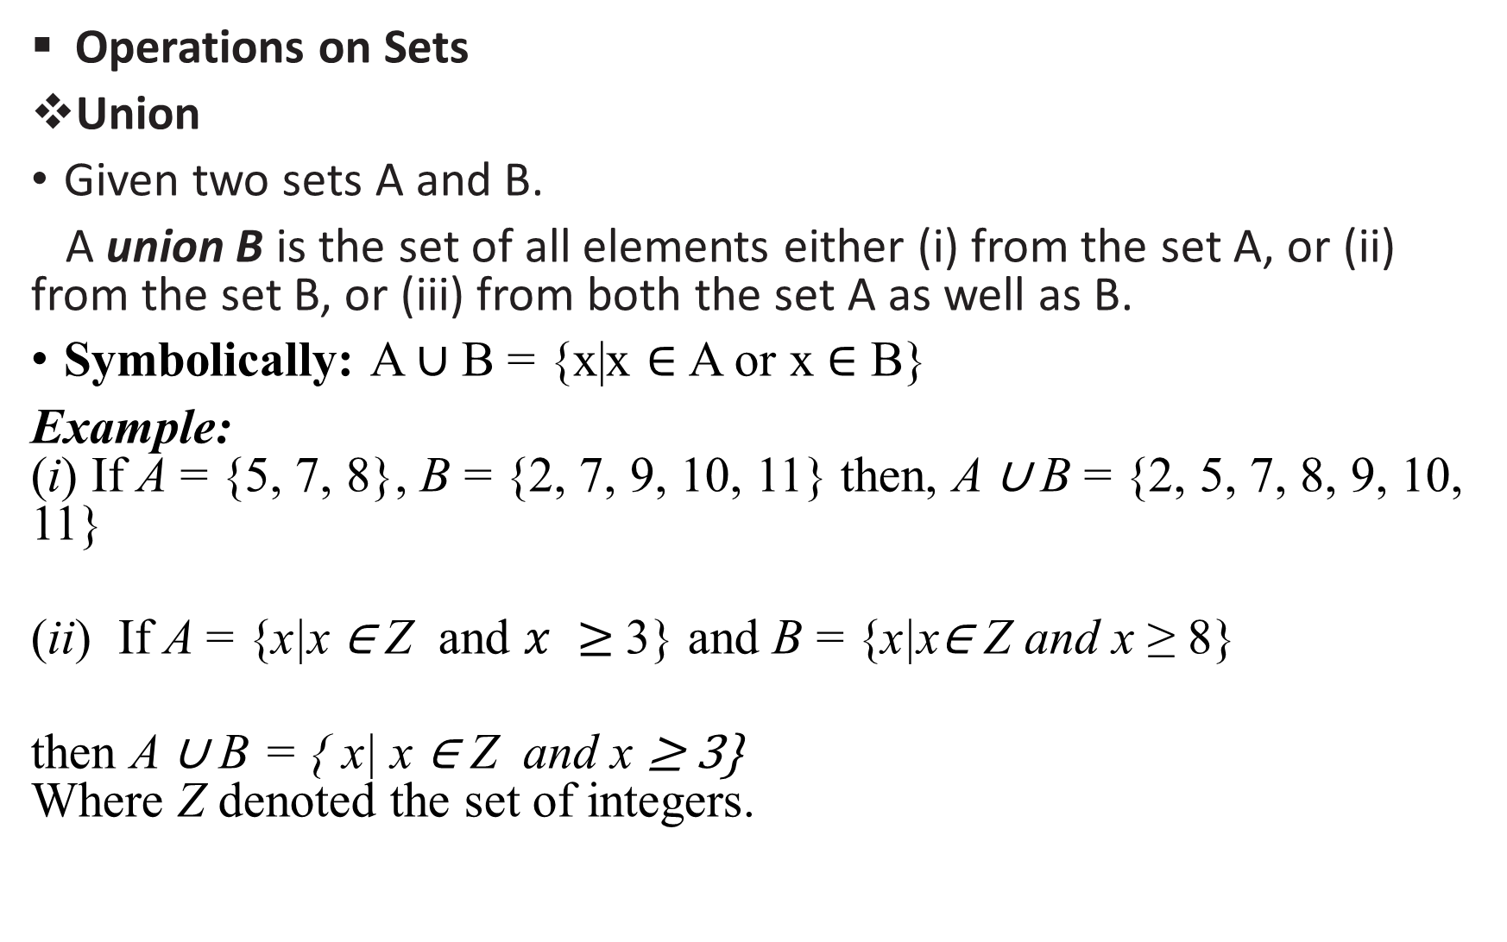
Operations on Sets
Union
Given two sets A and B.
A union B is the set of all elements either (i) from the set A, or (ii) from the set B, or (iii) from both the set A as well as B.
Symbolically: A ∪ B = {x|x ∈ A or x ∈ B}
Example: (i) If A = {5, 7, 8}, B = {2, 7, 9, 10, 11} then, A ∪ B = {2, 5, 7, 8, 9, 10, 11}
(ii) If A = {x|x ∈ Z and $x ≥$3} and B = {x|x∈ Z and x ≥ 8}
then A ∪ B = { x| x ∈ Z and x ≥ 3} Where Z denoted the set of integers.

Slide 26
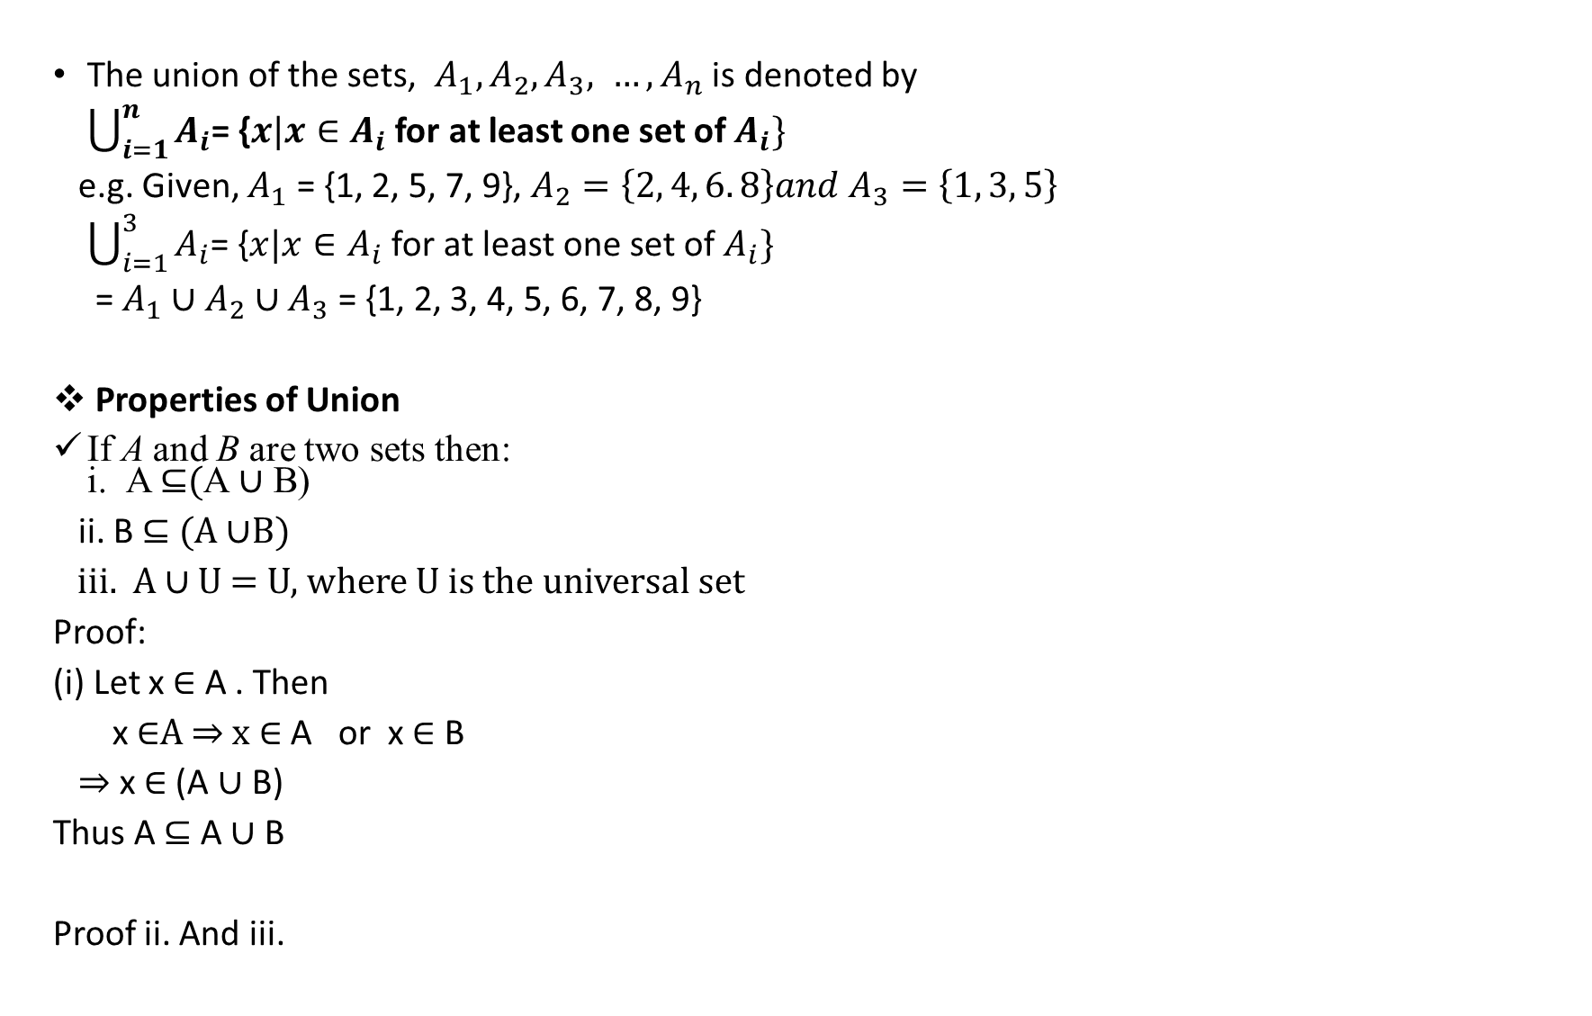
The union of the sets, $A_{1}, A_{2}, A_{3}, …, A_{n}$ is denoted by
$\bigcup_{i=1}^{n}{A_{i}}$= {$x|x∈A_{i}$ for at least one set of $A_{i}\}$
e.g. Given, $A_{1}$ = {1, 2, 5, 7, 9}, $A_{2}=\left\{2, 4, 6. 8\right\}and A_{3}=\left\{1, 3, 5\right\}$
$\bigcup_{i=1}^{3}{A_{i}}$= {$x|x∈A_{i}$ for at least one set of $A_{i}\}$
= $A_{1}∪A_{2}∪A_{3}$ = {1, 2, 3, 4, 5, 6, 7, 8, 9}
Properties of Union
If A and B are two sets then: i. A ⊆(A ∪ B)
ii. B ⊆ (A ∪B)
iii. A ∪ U = U, where U is the universal set
Proof:
(i) Let x ∈ A . Then
x ∈A ⇒ x ∈ A or x ∈ B
⇒ x ∈ (A ∪ B)
Thus A ⊆ A ∪ B
Proof ii. And iii.

Slide 27
If A is any set then (i) A ∪ φ = A (ii) A ∪ A = A
Proof:
(i) Clearly A ⊆ (A ∪ φ) … (1)
Conversely, let x ∈ A ∪ φ
x ∈ A ∪ ∅ ⇒ x ∈ A or x ∈ φ
⇒ x ∈ A
Try (ii)

Slide 28
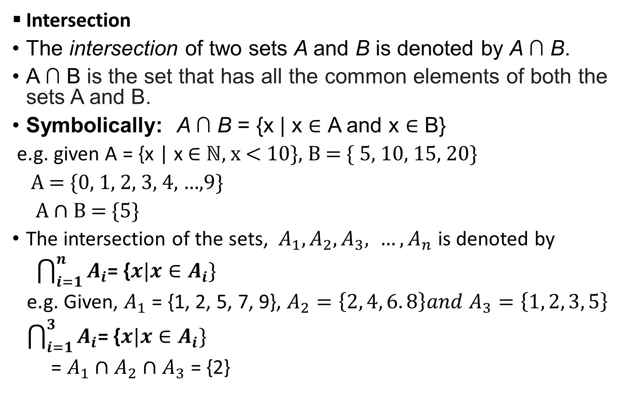
Intersection
The intersection of two sets A and B is denoted by A ∩ B.
A ∩ B is the set that has all the common elements of both the sets A and B.
Symbolically: A ∩ B = {x | x ∈ A and x ∈ B}
e.g. given A = {x | x ∈ ℕ, x < 10}, B = { 5, 10, 15, 20}
A = {0, 1, 2, 3, 4, …,9}
A ∩ B = {5}
The intersection of the sets, $A_{1}, A_{2}, A_{3}, …, A_{n}$ is denoted by
$\bigcap_{i=1}^{n}{A_{i}}$= {$x|x∈A_{i}\}$
e.g. Given, $A_{1}$ = {1, 2, 5, 7, 9}, $A_{2}=\left\{2, 4, 6. 8\right\}and A_{3}=\left\{1, 2, 3, 5\right\}$
$\bigcap_{i=1}^{3}{A_{i}}$= {$x|x∈A_{i}\}$
= $A_{1}∩A_{2}∩A_{3}$ = {2}

Slide 29
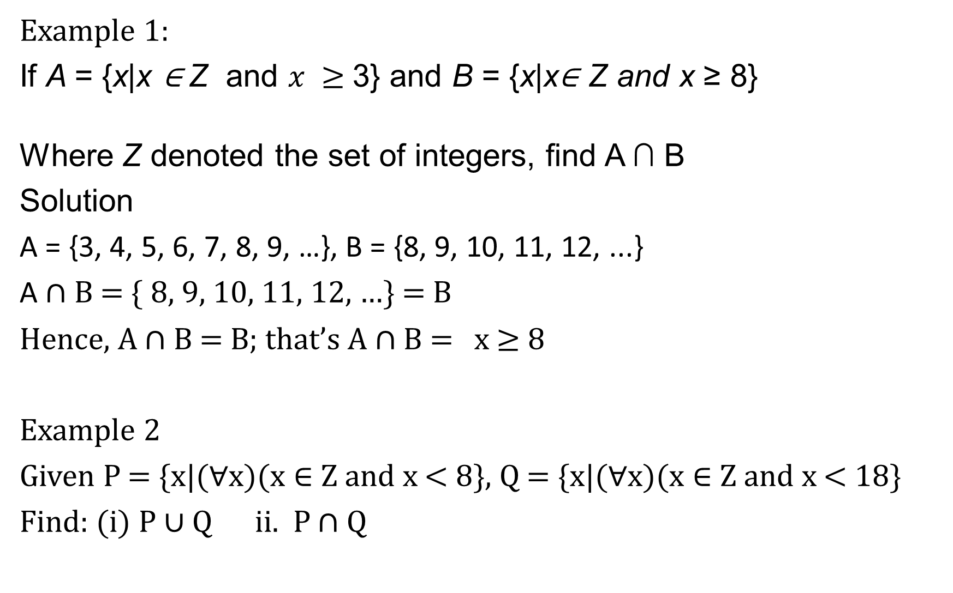
Example 1:
If A = {x|x ∈ Z and $x ≥$3} and B = {x|x∈ Z and x ≥ 8}
Where Z denoted the set of integers, find A ∩ B
Solution
A = {3, 4, 5, 6, 7, 8, 9, …}, B = {8, 9, 10, 11, 12, ...}
A ∩ B = { 8, 9, 10, 11, 12, …} = B
Hence, A ∩ B = B; that’s A ∩ B = x ≥ 8
Example 2
Given P = {x|(∀x)(x ∈ Z and x < 8}, Q = {x|(∀x)(x ∈ Z and x < 18}
Find: (i) P ∪ Q ii. P ∩ Q

Slide 30
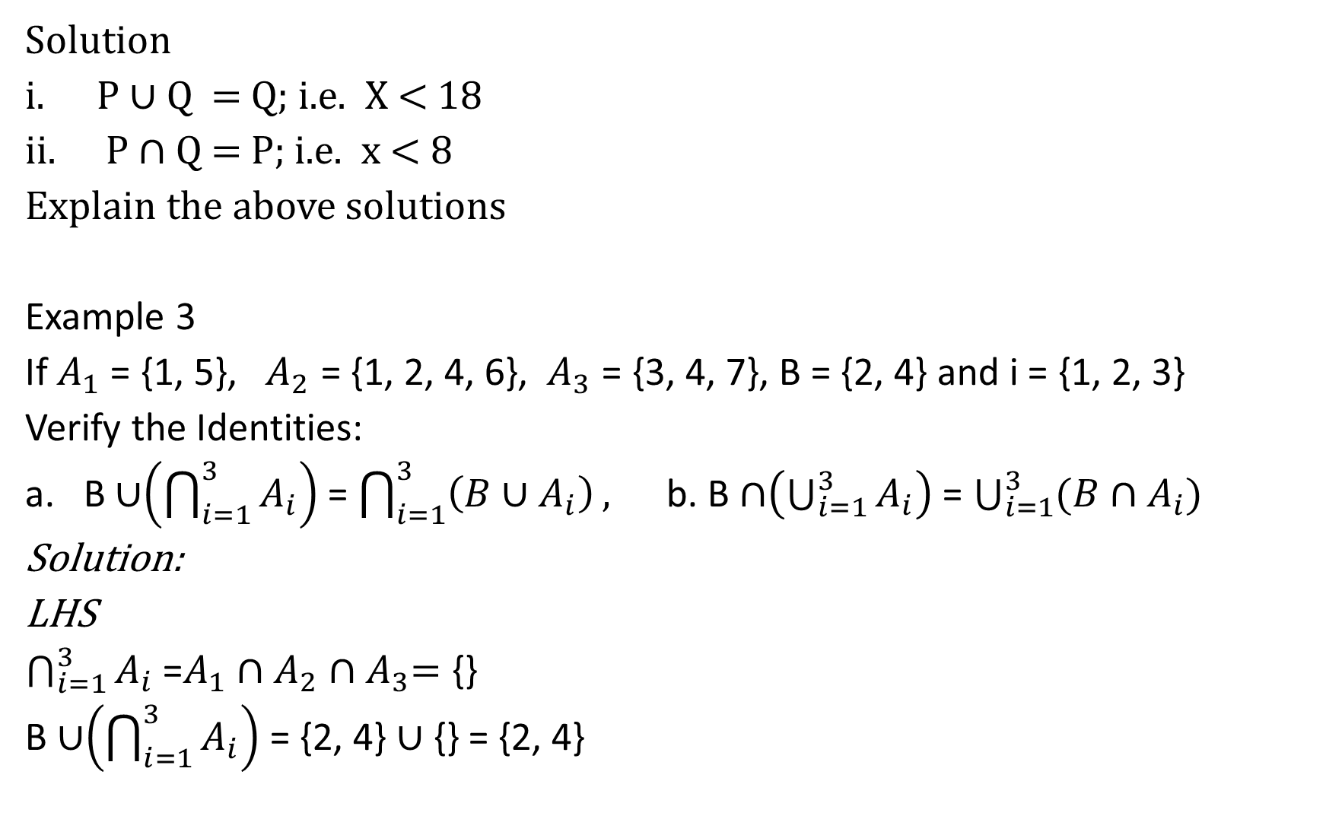
Solution
P ∪ Q = Q; i.e. X < 18
P ∩ Q = P; i.e. x < 8
Explain the above solutions
Example 3
If $A_{1}$ = {1, 5}, $A_{2}$ = {1, 2, 4, 6}, $A_{3}$ = {3, 4, 7}, B = {2, 4} and i = {1, 2, 3}
Verify the Identities:
a. B ∪$\left(\bigcap_{i=1}^{3}{A_{i}}\right)$ = $\bigcap_{i=1}^{3}{\left({B∪A}_{i}\right)},$ b. B ∩$\left(\bigcup_{i=1}^{3}{A_{i}}\right)$ = $\bigcup_{i=1}^{3}{(B∩A_{i})}$
Solution:
LHS
$\bigcap_{i=1}^{3}{A_{i}}$ =$A_{1}∩A_{2}{∩A}_{3}=$ {}
B ∪$\left(\bigcap_{i=1}^{3}{A_{i}}\right)$ = {2, 4} $∪$ {} = {2, 4}

Slide 31
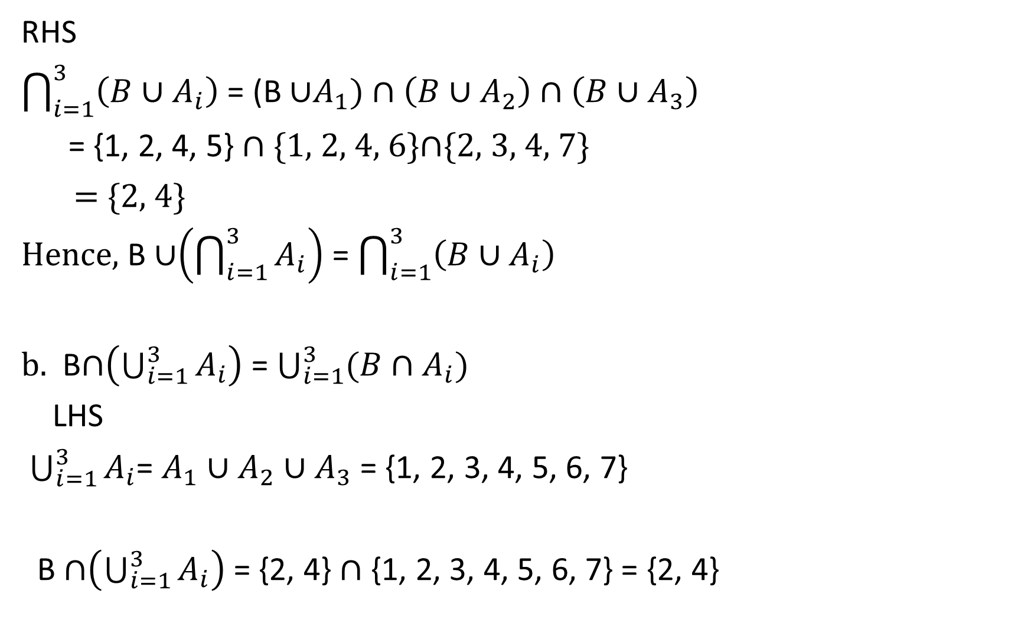
RHS
$\bigcap_{i=1}^{3}{\left({B∪A}_{i}\right)}$ = (B ∪$A_{1})∩\left(B∪A_{2}\right)∩\left(B∪A_{3}\right)$
= {1, 2, 4, 5} ∩ {1, 2, 4, 6}∩{2, 3, 4, 7}
= {2, 4}
Hence, B ∪$\left(\bigcap_{i=1}^{3}{A_{i}}\right)$ = $\bigcap_{i=1}^{3}{\left({B∪A}_{i}\right)}$
b. B∩$\left(\bigcup_{i=1}^{3}{A_{i}}\right)$ = $\bigcup_{i=1}^{3}{(B∩A_{i})}$
LHS
$\bigcup_{i=1}^{3}{A_{i}}$= $A_{1}∪A_{2}∪A_{3}$ = {1, 2, 3, 4, 5, 6, 7}
B ∩$\left(\bigcup_{i=1}^{3}{A_{i}}\right)$ = {2, 4} ∩ {1, 2, 3, 4, 5, 6, 7} = {2, 4}

Slide 32

RHS
$\bigcup_{i=1}^{3}{(B∩A_{i})}$ = (B ∩ $A_{1})∪(B∩A_{2})∪(B∩A_{3})$
= {} $∪\left\{2, 4\right\}∪\{4\}$ = {2, 4}
Hence, B ∩$\left(\bigcup_{i=1}^{3}{A_{i}}\right)$ = $\bigcup_{i=1}^{3}{(B∩A_{i})}$

Slide 33
Disjoint Sets
Two sets A and B are said to be disjoint if they have no common element, i.e. A ∩ B = ∅
E.g. i. {a, b, c} ∩ {1, 2} = { } or ∅ ii. {a, b, c} ∩ { } = { } or ∅ iii. {∅, a, b, c} ∩ { } = { } or ∅ iv. {∅, a, b, c} ∩ {{ }} = {∅}
From the above, I, ii and iii are disjoint but (iv) is not disjoint; explain why.

Slide 34
Property 1:
Every element x in A ∩ B belongs to both A and B; hence x belongs to A and x belongs to B. Thus A ∩ B is a subset of A and of B; namely
A ∩ B ⊆ A and A ∩ B ⊆ B
Theorem 1:
For any sets A and B, we have:
(i) A ∩ B ⊆ A ⊆ A ∪ B and (ii) A ∩ B ⊆ B ⊆ A ∪ B.
From the above, we can conclude that if,
A ∩ B ⊆ A ⊆ A ∪ B ⇒ A ∩ B ⊆ A ∪ B by applying chain rule (i.e. the
law of syllogism in Logic)
The operation of set inclusion is closely related to the operations of union and intersection, as shown by the following theorem.

Slide 35
Theorem 2:
The following are equivalent: if A ⊆ B, then
A ∩ B = A,
A ∪ B = B.
Both union and intersection are commutative and associative:
Example 3:
Set X = {x/x is an integer s.t. x ≥ 10}, Y = {1, 2, 3, …..} and Z = {3, 5, 7, 9} find
a. i. X ∪ Y, ii. Y ∪ X, iii. Y ∩ Z, iv. Z ∩ Y v. X ∩ Y vi X ∩ Z.
Commutativity | Associativity
A ∪ B = B ∪ A | A ∪ (B ∪ C) = (A ∪ B) ∪ C
A ∩ B = B ∩ A | A ∩ (B ∩ C) = (A ∩ B) ∩ C

Slide 36
b. Hence, show that X ∪ Y = Y and Y ∩ Z = Z
Solution
a. X = { 10, 11, 12, 13, 14,…}; Y = {1, 2, 3, 4, …} and Z = {3, 5, 7, 9}
i. X ∪ Y = {1, 2, 3, 4…..}
ii. Y ∪ X = {1, 2, 3, 4, …}
iii. Y ∩ Z = {3, 5, 7, 9}
iv. Z ∩ Y = {3, 5, 7, 9}
v. X ∩ Y = {10, 11, 12, 13, 14, …}
vi X ∩ Z. = ∅
b. From the above, X ∪ Y = Y and Y ∩ Z = Z, since X ⊂ Y and Z ⊂ Y

Slide 37
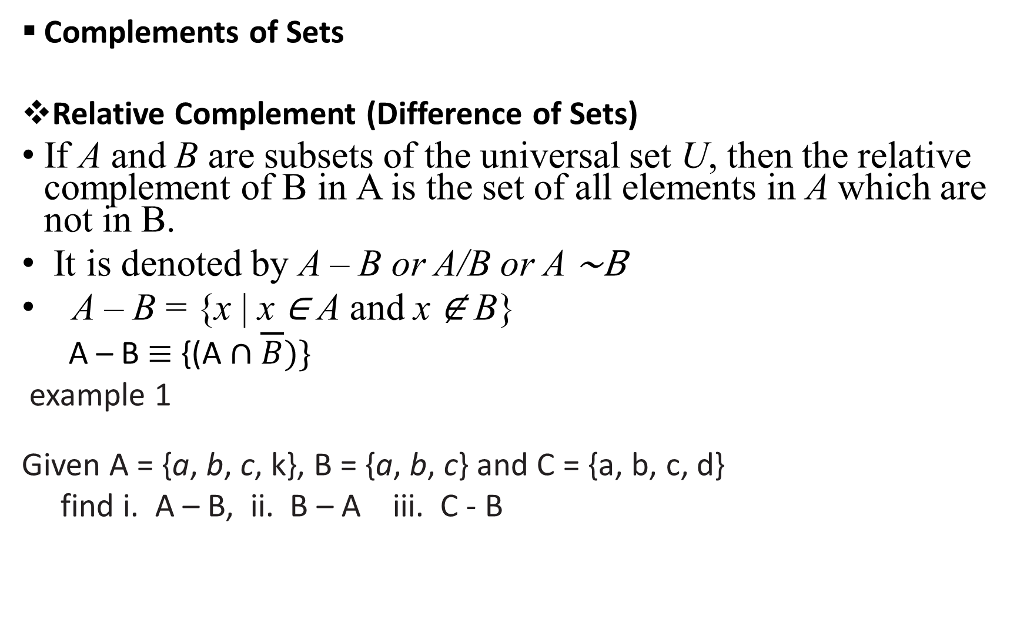
Complements of Sets
Relative Complement (Difference of Sets)
If A and B are subsets of the universal set U, then the relative complement of B in A is the set of all elements in A which are not in B.
It is denoted by A – B or A/B or A ∼B
A – B = {x | x ∈ A and x ∉ B}
A – B ≡ {(A ∩ $\overline{B}$)}
example 1
Given A = {a, b, c, k}, B = {a, b, c} and C = {a, b, c, d}
find i. A – B, ii. B – A iii. C - B

Slide 38
Solution
i. A – B = {k}
ii. B – A = ∅
iii. C – B = {d}
Example 2
Given, A = {2, 3, 5, 7, 11, 13}, B = {1, 3, 5, 7, 9} and C = {1, {2, 3,5}, 7, 9}
Find i. A – B; ii. B – A; iii. A – C; iv. C – A; v. B – C; vi. C – B
Solution
A – B = {2, 11, 13}
B – A = {1, 9}
A – C = {2, 3, 5, 11, 13}

Slide 39
iv. C – A = {1, {2,3,5}, 9}
v. B – C = {3, 5}
vi. C – B = {{2, 3, 5}}
The difference of two sets is not commutative;
i.e. A – B ≠ B - A and A – C ≠ C – A
Try
If A = {1, 3, 5, 7, 8, 9} and B = {3, 5, 8}
then verify that:
a. (A – B) ∪ (B – A) = (A ∪ B) – (A ∩ B)
b. B ∩ (A - B) = ∅
Symmetric Difference
Given the two sets A and B, the symmetric difference of A and B, is denoted by A ⨁ B.
A ⊕ B is the set of all the elements of A or B but not in both.
A ⨁ B = {x/x ∈ (A – B) ∪ x ∈ (B – A)} or {(A ∪ B)-(A∩B)}

Slide 40
example 1
Given A = {a, b, c, k}, B = {a, b, c} and C = {a, b, c, d}
find i. A ⨁ B, ii. B ⨁ A iii. C ⊕ B
solution:
i. A ⨁ B = {k}
ii. B ⨁ A = {k}
iii. C ⊕ B = {d}
Example 2
Given, A = {2, 3, 5, 7, 11, 13}, B = {1, 3, 5, 7, 9} and C = {1, {2, 3,5}, 7, 9}
Find i. A ⨁ B; ii. B ⨁ A; iii. A ⨁ C; iv. C ⨁ A; v. B ⨁ C;

Slide 41
Solution:
A = {2, 3, 5, 7, 11, 13}, B = {1, 3, 5, 7, 9} and C = {1, {2, 3,5}, 7, 9}
A ⨁ B = {1, 2, 9,11,13}
B ⨁ A = {1, 2, 9, 11, 13}
A ⨁ C = {1, {2, 3, 5} 2, 3, 5, 9, 11, 13}
C ⨁ A = {1, {2, 3, 5} 2, 3, 5, 9, 11, 13}
B ⨁ C = {{2, 3, 5}, 3}
it can be seen that symmetric difference is commutative
i.e. A ⨁ B = B ⨁ A; A ⨁ C = C ⨁ A

Slide 42
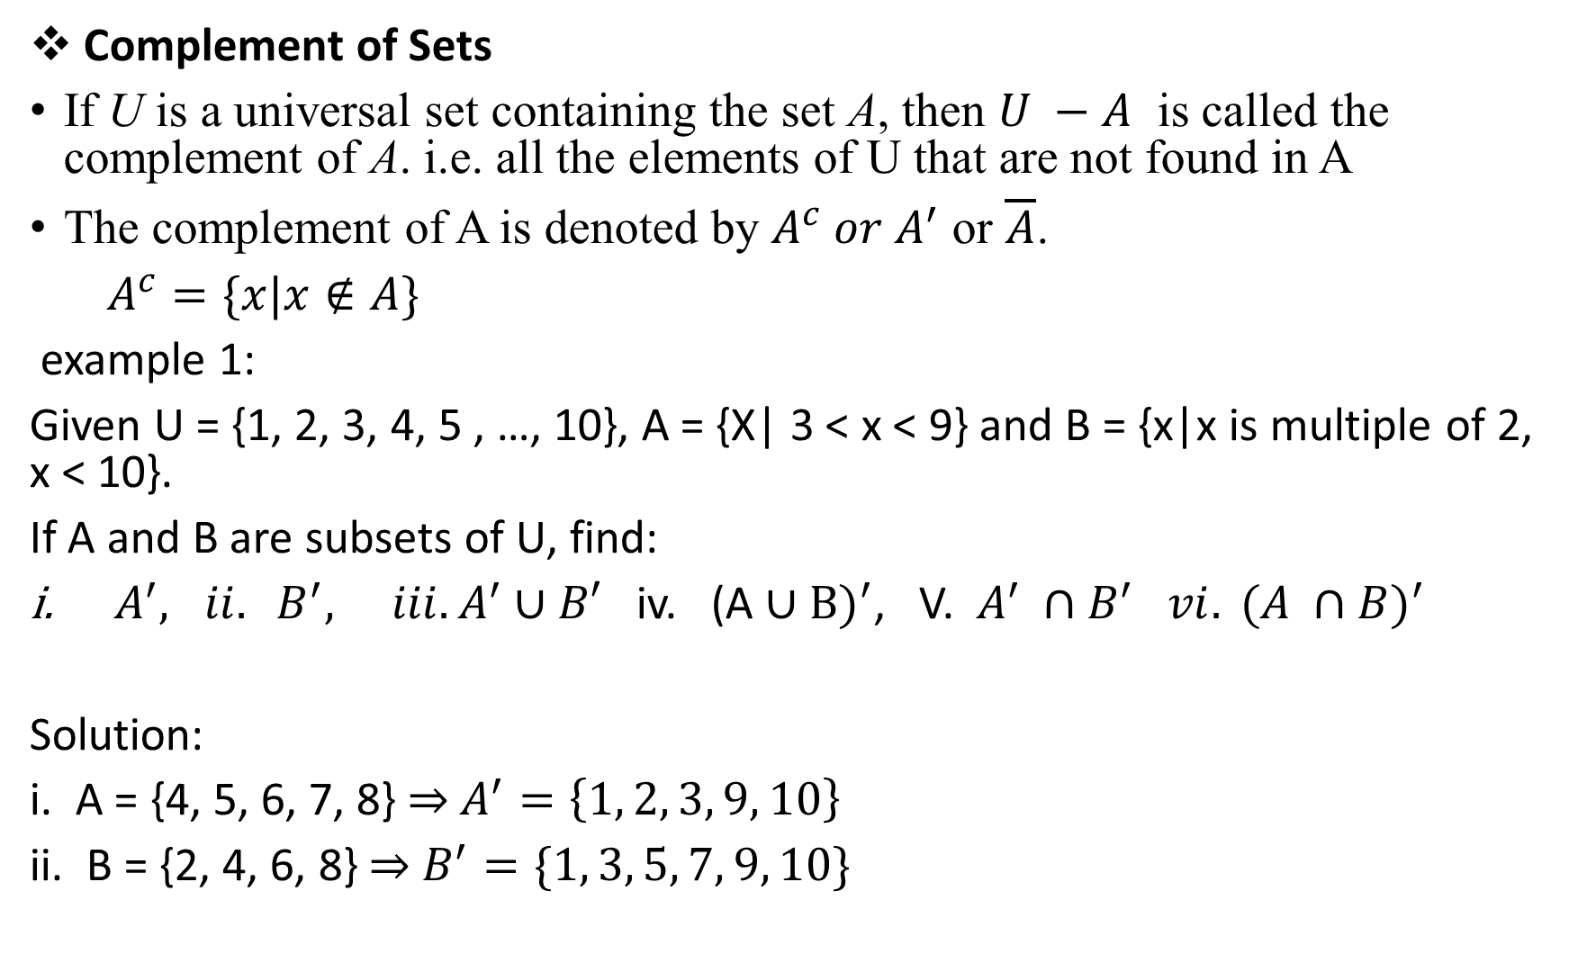
Complement of Sets
If U is a universal set containing the set A, then $U −A$ is called the complement of A. i.e. all the elements of U that are not found in A
The complement of A is denoted by $A^{c} or A^{′}$ or $\overline{A}$.
$A^{c}=\{x|x∉A\}$
example 1:
Given U = {1, 2, 3, 4, 5 , …, 10}, A = {X| 3 < x < 9} and B = {x|x is multiple of 2, x < 10}.
If A and B are subsets of U, find:
$A^{′}, ii. B^{′}, iii. A^{′}∪B′$ iv. (A ∪ B$)^{′}$, V. $A^{′} ∩B^{′} vi. (A ∩B)^{′}$
Solution:
i. A = {4, 5, 6, 7, 8} ⇒ $A^{′}=\left\{1, 2, 3, 9, 10\right\}$
ii. B = {2, 4, 6, 8} ⇒ $B^{′}=\{1, 3, 5, 7, 9, 10\}$

Slide 43
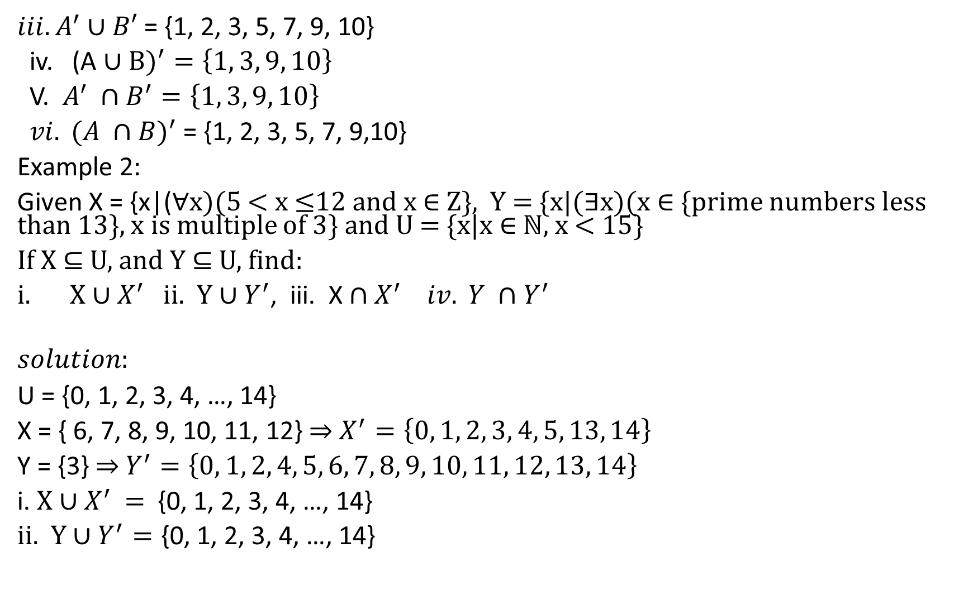
$iii. A^{′}∪B′$ = {1, 2, 3, 5, 7, 9, 10}
iv. (A ∪ B$)^{′}=\left\{1, 3, 9, 10\right\}$
V. $A^{′} ∩B^{′}=\left\{1, 3, 9, 10\right\}$
$vi. (A ∩B)^{′}$ = {1, 2, 3, 5, 7, 9,10}
Example 2:
Given X = {x|(∀x)(5 < x ≤12 and x ∈ Z}, Y = {x|(∃x)(x ∈ {prime numbers less than 13}, x is multiple of 3} and U = {x|x ∈ ℕ, x < 15}
If X ⊆ U, and Y ⊆ U, find:
X ∪ $X^{′}$ ii. Y ∪ $Y^{′}$, iii. X ${∩X}^{′} iv. Y ∩Y^{′}$
$$solution:$$
U = {0, 1, 2, 3, 4, …, 14}
X = { 6, 7, 8, 9, 10, 11, 12} ⇒ $X^{′}=\left\{0, 1, 2, 3, 4, 5, 13, 14\right\}$
Y = {3} ⇒ $Y^{′}=\left\{0, 1, 2, 4, 5, 6, 7, 8, 9, 10, 11, 12, 13, 14\right\}$
i. X ∪ $X^{′}$ = {0, 1, 2, 3, 4, …, 14}
ii. Y ∪ $Y^{′}=\text{\{0, 1, 2, 3, 4, …, 14\}}$

Slide 44
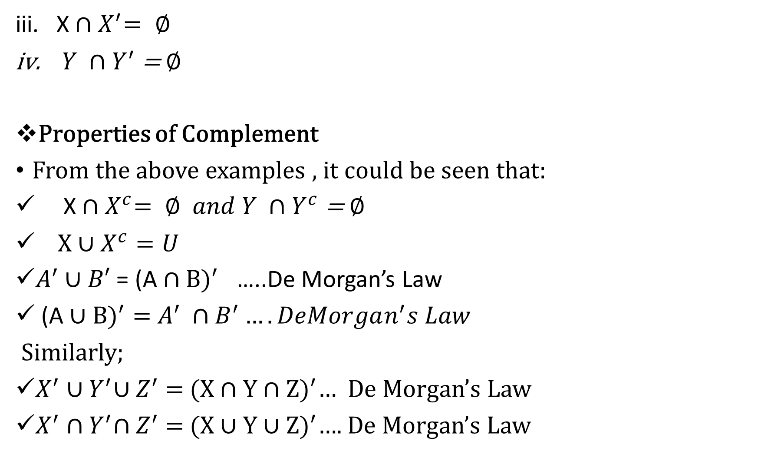
X ${∩X}^{′}= ∅$
$Y ∩Y^{′}$= ∅
Properties of Complement
From the above examples , it could be seen that:
X ${∩X}^{c}= ∅ and Y ∩Y^{c}$= ∅
X ∪ $X^{c}=U$
$A^{′}∪B′$ = (A ∩ B$)^{′}$ …..De Morgan’s Law
(A ∪ B$)^{′}=$ $A^{′} ∩B^{′}….DeMorgan^{′}s Law$
Similarly;
$X^{′}{∪Y}^{′}{∪Z}^{′}$ = (X ∩ Y ∩ Z$)^{′}$… De Morgan’s Law
$X^{′}{∩Y}^{′}{∩Z}^{′}$ = (X ∪ Y ∪ Z$)^{′}$…. De Morgan’s Law

Slide 45
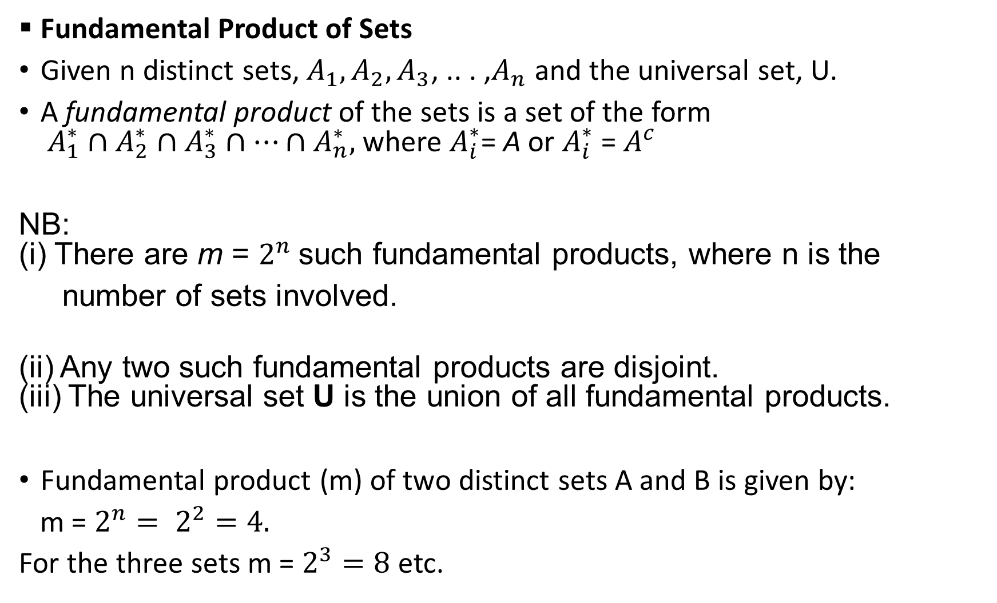
Fundamental Product of Sets
Given n distinct sets, $A_{1}, A_{2}, A_{3}$, .. . ,$A_{n}$ and the universal set, U.
A fundamental product of the sets is a set of the form $A_{1}^{∗}∩A_{2}^{∗}∩A_{3}^{∗}∩…∩A_{n}^{∗},$where $A_{i}^{∗}$= A or $A_{i}^{∗}$ = $A^{c}$
NB: (i) There are m = $2^{n}$ such fundamental products, where n is the
number of sets involved.
(ii) Any two such fundamental products are disjoint. (iii) The universal set U is the union of all fundamental products.
Fundamental product (m) of two distinct sets A and B is given by:
m = $2^{n}= 2^{2}=4.$
For the three sets m = $2^{3}=8$ etc.

Slide 46

Lets illustrate the fundamental products on a Venn diagram:
a. For two sets A and B
U
A B
$p_{2}$ $p_{1}$ $p_{3}$
$p_{4}$
$p_{1}$ = A ∩ B
$p_{2}$ = A ∩ $B^{c}$
$p_{3}$ = $A^{c}$ ∩ B
$p_{4}$ = $A^{c}∩B^{c}$
m = $2^{n}=4$

Slide 47

For three sets A, B and C
U $p_{1}=A∩B∩C$
A $P_{2}$ = $A^{c}∩B∩C$
$p_{5}$ C $P_{3}$ = A${∩B}^{c}∩C$
$p_{4}$ $p_{1}$ ${ p}_{3}$ $P_{4} =A∩B∩C^{c}$
B $p_{6}$ $p_{2}$ $p_{7}$ $P_{5} =A∩B^{c}∩C^{c}$
$p_{8}$ ${ P}_{6} =A^{c}∩B∩C^{c}$
${ P}_{7} =A^{c}∩B^{c}∩C$
$P_{8} =A^{c}∩B^{c}∩C^{c}$
m = $2^{3}=8$

Slide 48
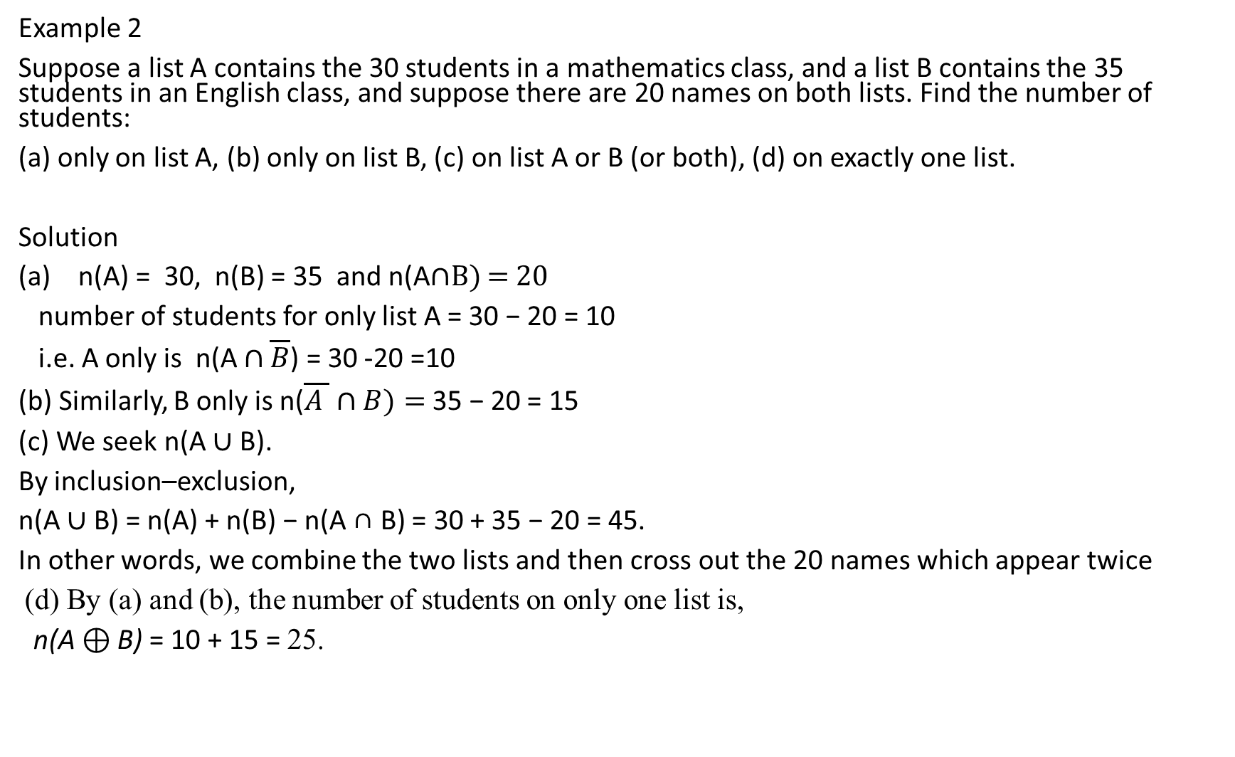
Example 2
Suppose a list A contains the 30 students in a mathematics class, and a list B contains the 35 students in an English class, and suppose there are 20 names on both lists. Find the number of students:
(a) only on list A, (b) only on list B, (c) on list A or B (or both), (d) on exactly one list.
Solution
n(A) = 30, n(B) = 35 and n(A∩B) = 20
number of students for only list A = 30 − 20 = 10
i.e. A only is n(A ∩ $\overline{B}$) = 30 -20 =10
(b) Similarly, B only is n($\overline{A }∩B)=$ 35 − 20 = 15
(c) We seek n(A ∪ B).
By inclusion–exclusion,
n(A ∪ B) = n(A) + n(B) − n(A ∩ B) = 30 + 35 − 20 = 45.
In other words, we combine the two lists and then cross out the 20 names which appear twice
(d) By (a) and (b), the number of students on only one list is,
n(A ⊕ B) = 10 + 15 = 25.

Slide 49
We can use Venn diagram:
n(U) = 45
n(A)=30 n(B)= 35
30-20 20 35 -20

Slide 50
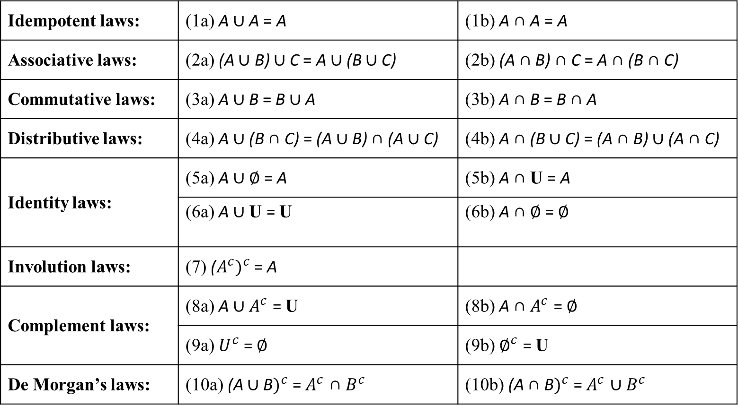
Laws of Algebra of Sets
The algebra laws are tabulated below:
Idempotent laws: | (1a) A ∪ A = A | (1b) A ∩ A = A
Associative laws: | (2a) (A ∪ B) ∪ C = A ∪ (B ∪ C) | (2b) (A ∩ B) ∩ C = A ∩ (B ∩ C)
Commutative laws: | (3a) A ∪ B = B ∪ A | (3b) A ∩ B = B ∩ A
Distributive laws: | (4a) A ∪ (B ∩ C) = (A ∪ B) ∩ (A ∪ C) | (4b) A ∩ (B ∪ C) = (A ∩ B) ∪ (A ∩ C)
Identity laws: | (5a) A ∪ ∅ = A | (5b) A ∩ U = A
 | (6a) A ∪ U = U | (6b) A ∩ ∅ = ∅
Involution laws: | (7) (${A^{c})}^{c}$= A
Complement laws: | (8a) A ∪ $A^{c}$ = U | (8b) A ∩ $A^{c}$ = ∅
 | (9a) $U^{c}$ = ∅ | (9b) $∅^{c}$ = U
De Morgan’s laws: | (10a) (A ∪ B$)^{c}$ = $A^{c}$ ∩ $B^{c}$ | (10b) (A ∩ B$)^{c}$ = $A^{c}$ ∪ $B^{c}$

Slide 51
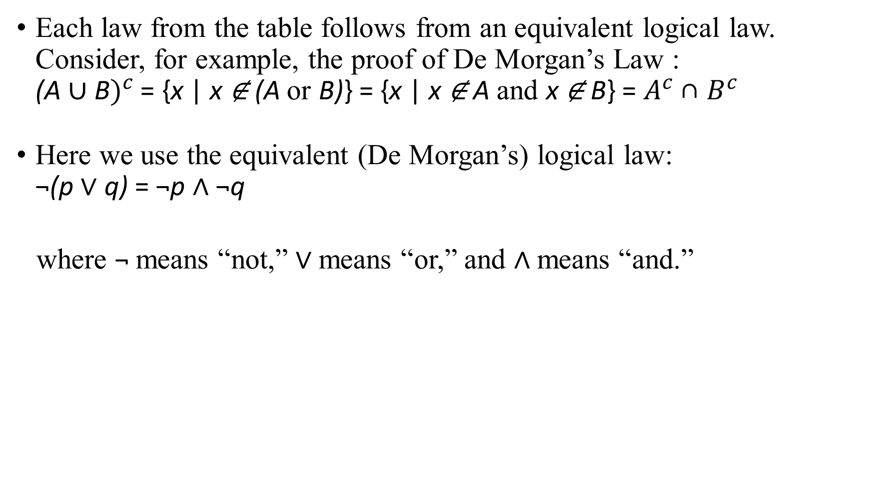
Each law from the table follows from an equivalent logical law. Consider, for example, the proof of De Morgan’s Law : (A ∪ B$)^{c}$ = {x | x ∉ (A or B)} = {x | x ∉ A and x ∉ B} = $A^{c}$ ∩ $B^{c}$
Here we use the equivalent (De Morgan’s) logical law: ¬(p ∨ q) = ¬p ∧ ¬q
where ¬ means “not,” ∨ means “or,” and ∧ means “and.”

Slide 52
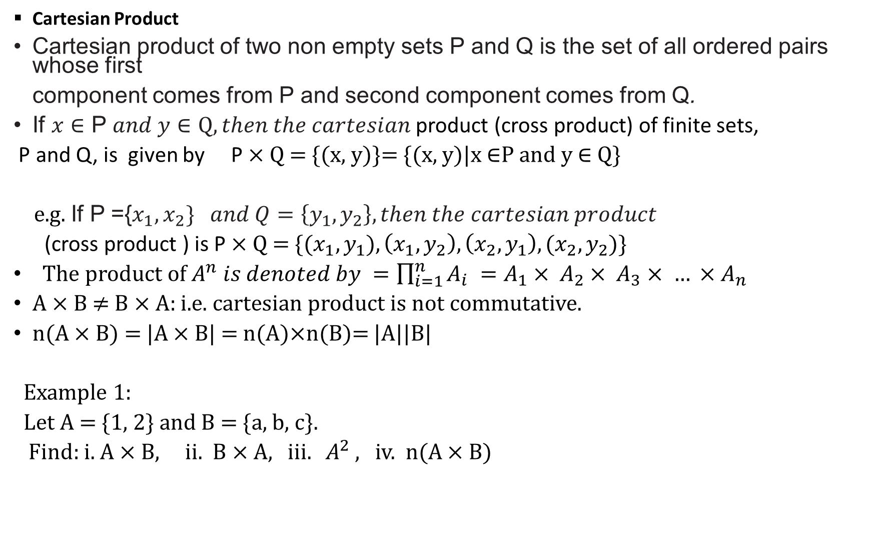
Cartesian Product
Cartesian product of two non empty sets P and Q is the set of all ordered pairs whose first
component comes from P and second component comes from Q.
If $x∈$ P $and y∈Q, then the cartesian$product (cross product) of finite sets,
P and Q, is given by P × Q = {(x, y)}= {(x, y)|x ∈P and y ∈ Q}
e.g. If P ={$x_{1}, x_{2}\} and Q=\left\{y_{1}, y_{2}\right\}, then the cartesian product$
(cross product ) is P × Q = {($x_{1},y_{1}), \left(x_{1}, y_{2}\right), \left(x_{2}, y_{1}\right), {(x}_{2}, y_{2}$)}
The product of $A^{n} is denoted by =\prod_{i=1}^{n}{A_{i}} =A_{1}× A_{2}{× A}_{3}{ × … ×A}_{n}$
A × B ≠ B × A: i.e. cartesian product is not commutative.
n(A × B) = |A × B| = n(A)×n(B)= |A||B|
Example 1:
Let A = {1, 2} and B = {a, b, c}.
Find: i. A × B, ii. B × A, $iii. A^{2}$ , iv. n(A × B)

Slide 53
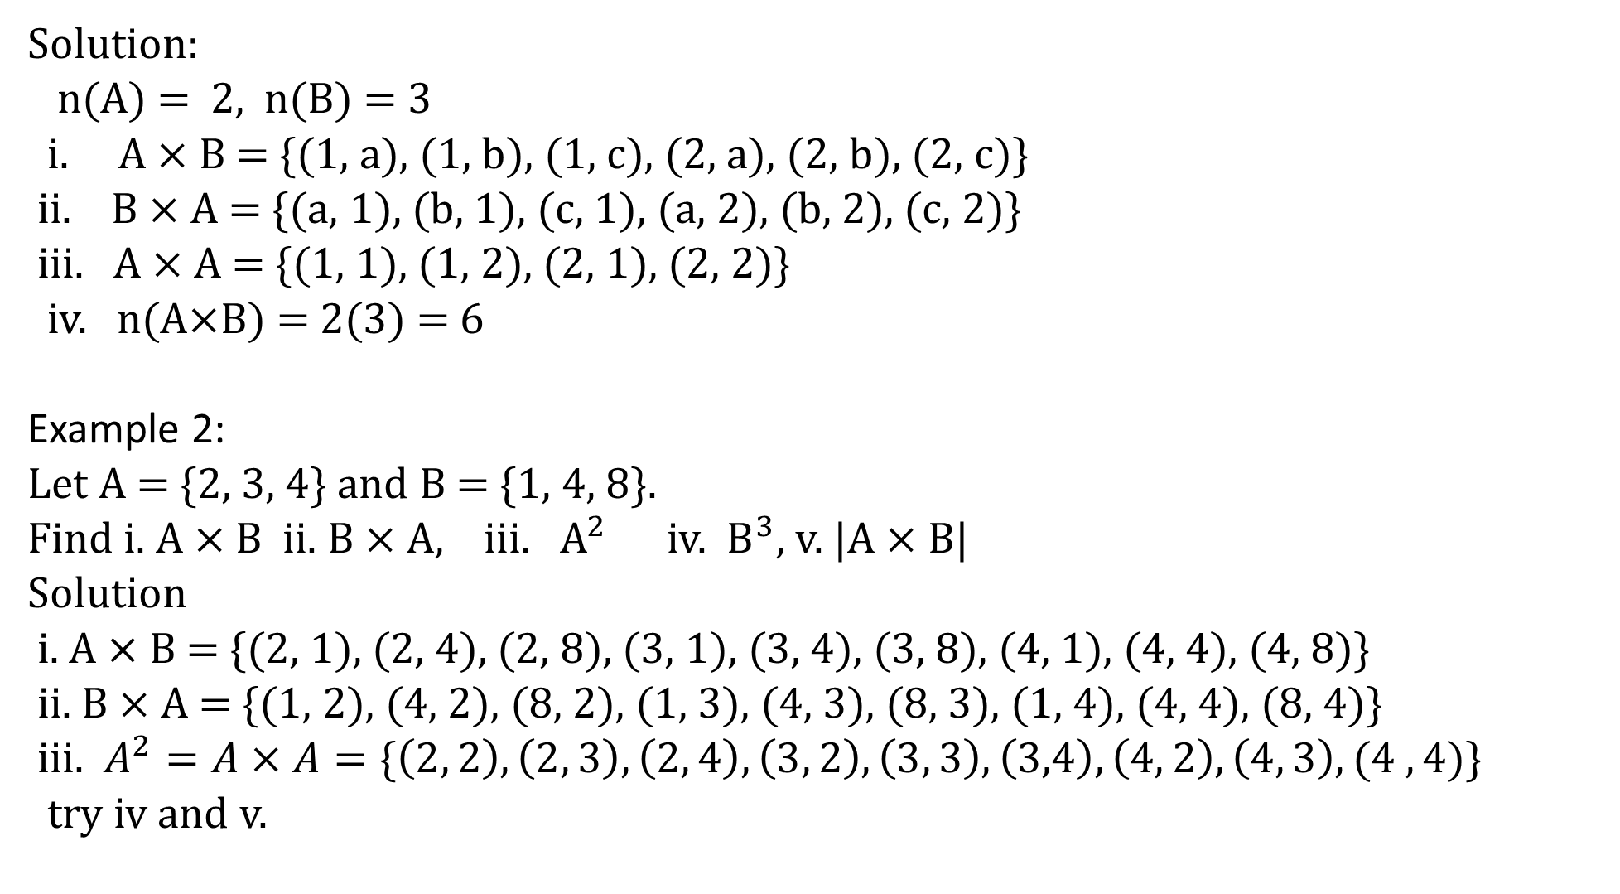
Solution:
n(A) = 2, n(B) = 3
i. A × B = {(1, a), (1, b), (1, c), (2, a), (2, b), (2, c)}
ii. B × A = {(a, 1), (b, 1), (c, 1), (a, 2), (b, 2), (c, 2)}
iii. A × A = {(1, 1), (1, 2), (2, 1), (2, 2)}
iv. n(A×B) = 2(3) = 6
Example 2:
Let A = {2, 3, 4} and B = {1, 4, 8}.
Find i. A × B ii. B × A, iii. $A^{2}$ iv. $B^{3}$, v. |A × B|
Solution
i. A × B = {(2, 1), (2, 4), (2, 8), (3, 1), (3, 4), (3, 8), (4, 1), (4, 4), (4, 8)}
ii. B × A = {(1, 2), (4, 2), (8, 2), (1, 3), (4, 3), (8, 3), (1, 4), (4, 4), (8, 4)}
iii. $A^{2}=A×A=\{\left(2, 2\right), \left(2, 3\right), \left(2, 4\right), \left(3, 2\right),\left(3, 3\right), \left(3,4\right),\left(4, 2\right), \left(4, 3\right),(4 ,4)$}
try iv and v.

Slide 54
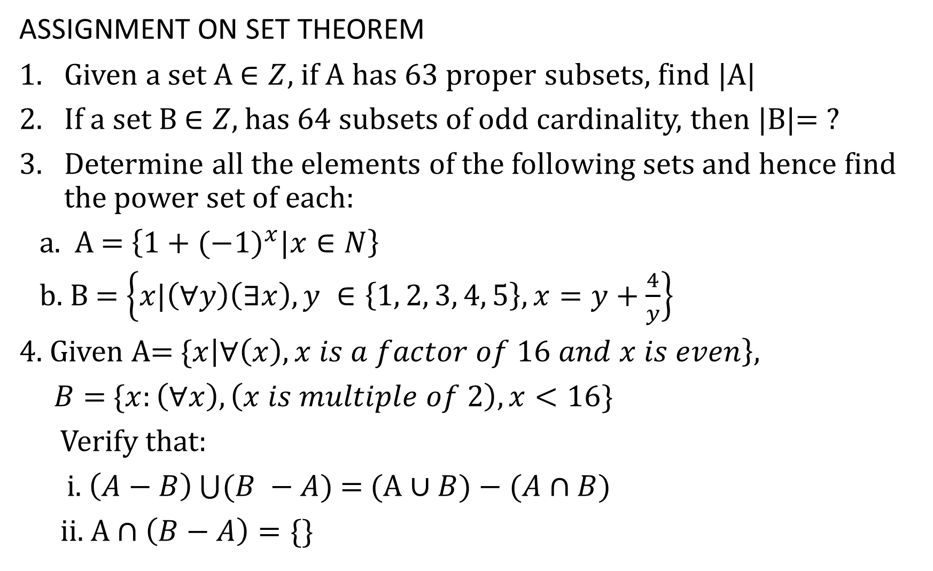
ASSIGNMENT ON SET THEOREM
Given a set A $∈Z$, if A has 63 proper subsets, find |A|
If a set B $∈Z,$has 64 subsets of odd cardinality, then |B|= ?
Determine all the elements of the following sets and hence find the power set of each:
a. A = $\left\{1+(−1)^{x}|x∈N\right\}$
b. B = $\left\{x|\left(∀y\right)\left(∃x\right), y ∈\left\{1, 2, 3, 4, 5\right\}, x=y+\frac{4}{y}\right\}$
4. Given A= {$x\left|∀\left(x\right), x is a factor of 16 and x is even\right\},$
$B=$ {$x:\left(∀x\right), \left(x is multiple of 2\right), x<16\}$
Verify that:
i. $\left(A−B\right)\bigcup{(B −A)}$ = (A $∪B)−(A∩B)$
ii. A $∩\left(B−A\right)=\{\}$

